Slide 1
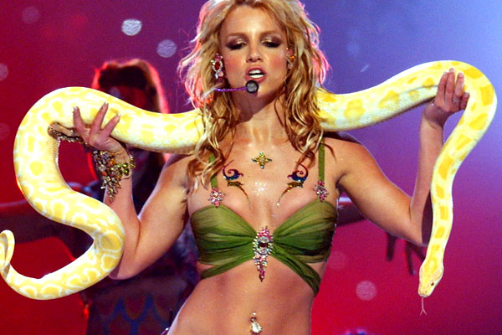
Python-ization at RTR
Anna Smith
@OMGannaks
Notes:
Ode to the VMAs that just happened

Slide 2

Notes:
Cinderella moments, disruptive to industry

Slide 3

Notes:
Pop culture -> desire for designer fashion
Democratize fashion -> real designers at affordable prices

Slide 4
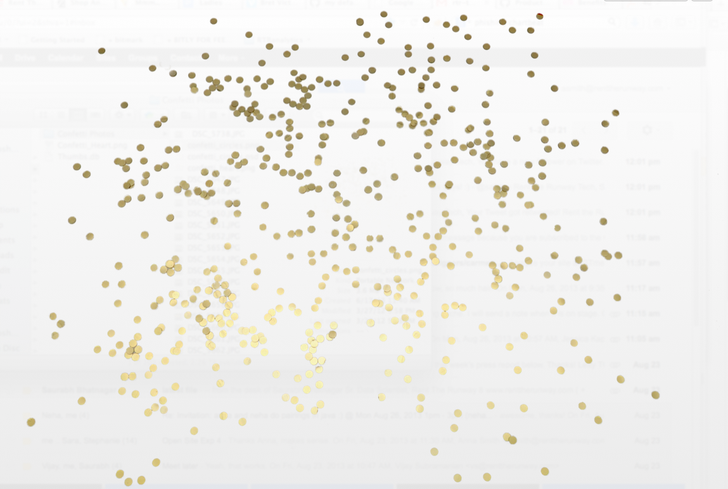
Notes:
Analytics is what makes us sparkle

Slide 5
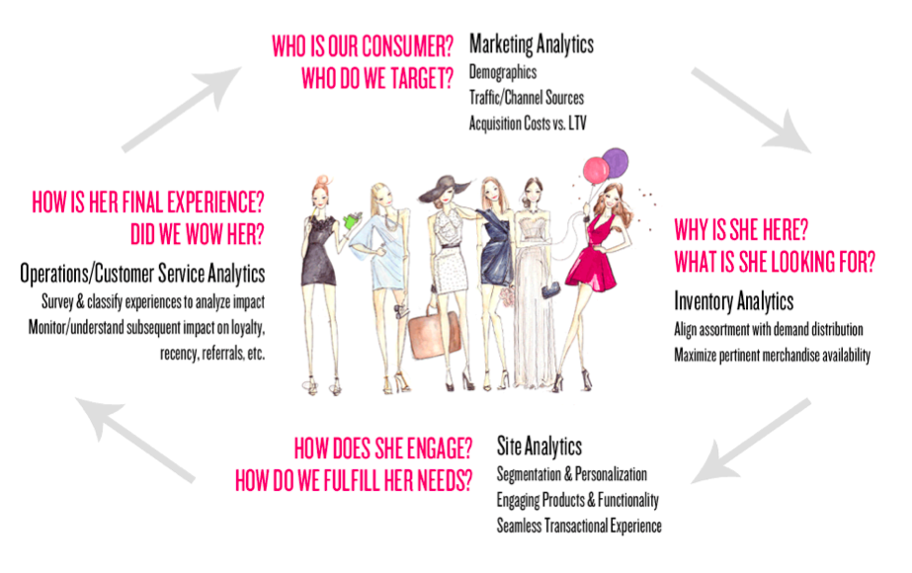

Slide 6
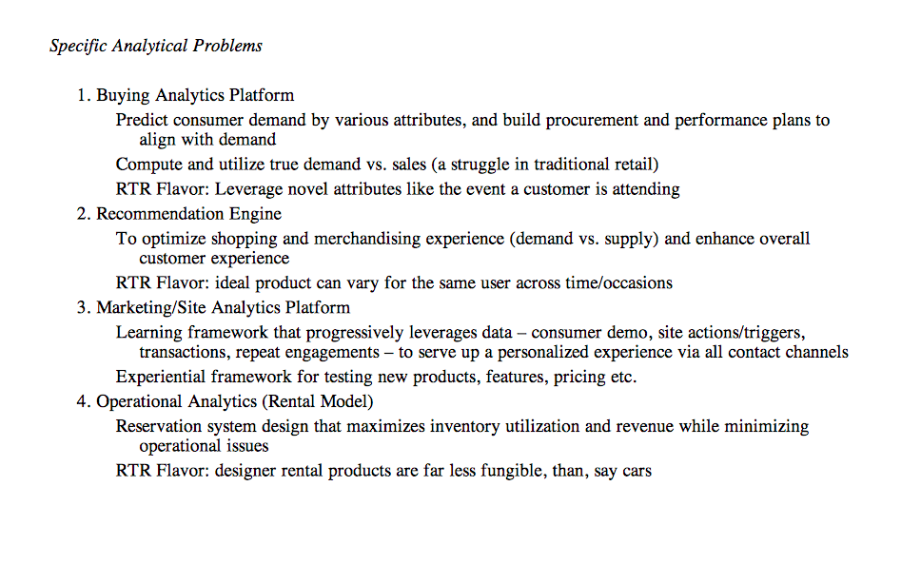

Slide 7
NOTE: I have opinions but I can’t tell you why
Notes:
if you have ideas/suggestions please say so!
let me know, interrupt, tell me i'm wrong! (in whatever form you are comfortable).
(fake it till you make it)

Slide 8
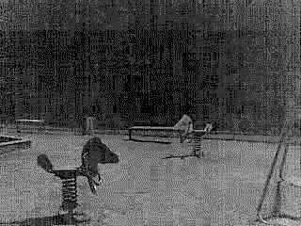

Notes:
Early commits to the inherited codebase

Slide 9
First Reactions
TOUCH ALL the THINGS
FOUR languages ALL IMPLEMENTED THE SAME WAY
PHP, Perl, Python, JS
EXCEL-lence
Python written like Java…
Ie, TOO MANY lines!
IMPORTS in middle of files!

Slide 10
Example

Slide 11
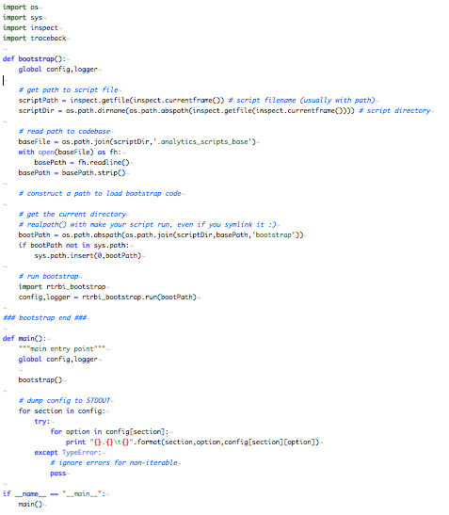
Example

Slide 12
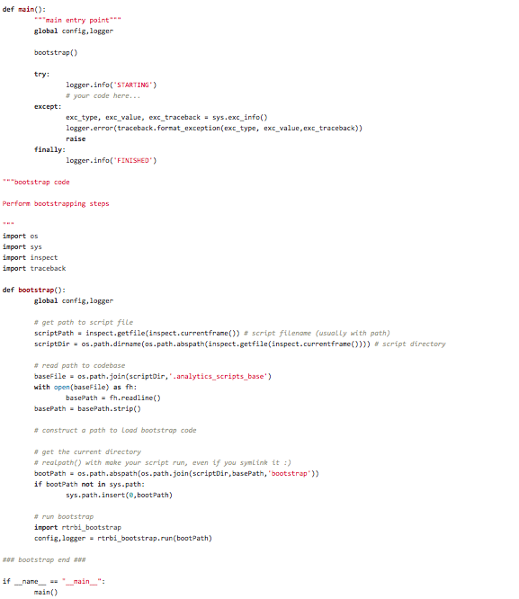
Example

Slide 13
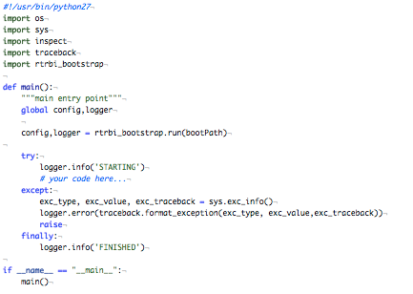
Example

Slide 14
Example
/usr/local/lib/python2.7/site-packages/ /usr/lib/python2.4/site-packages/ /usr/lib/python2.6/site-packages/

Slide 15
Let’s talk about sys.path
Check your paths: `import sys; print sys.path`
Current directory is ALWAYS first: path[0] = ‘’
Initialized from $PYTHONPATH upon interpreter startup
`*/site-packages/*.pth`
deduped, can import to execute lines, checks for existence
Both local and full path specific: eg. `/usr/local/lib/pythonX.Y/site-packages/bar`

Slide 16
Example
This still doesn’t feel right…
Notes:
For dumb programmers?

Slide 17

How do you say Excel in Python?
Notes:
Viewers can modify – not pretty – basically a whole new way of dealing with data – copy and pasting incorporates errors

Slide 18
“how to convert excel to python”
Actually really helpful results!
Create an action plan
Reproduce their results
Make extensible
Major Refactoring leads to speed improvements, easier to use, less error prone, prettier, can be used for other things
SO PRETTY
D3 all the things
viewer’s can’t adjust numbers, no copy errors

Slide 19

Teaching Python

Slide 20
General Tips/Tricks
Learn Python the Hard Way
Instructions: exercises plus code samples
Python Style Tips
PEP8
Take ideas from other people, condense it
The Bitly Way: eg no * imports, descriptive variables, logging.info instead of print, docstrings – the why, what, and how
Pyflakes! (serious life saver)

Slide 21
GIT ‘er Done
Have a pet project!
Just get started
Really, just do it
Mostly Google & StackOverflow :)
95% of what I do in a day
Look at other people’s code
GIT GIT GIT
GIT BRANCHES ZOMG YES

Slide 22
I’m Serious about Git
Most overlooked piece in analytics/data science/wtf you want to call it
Peer Review is SO amazing
Faster to learn
You have real feedback! And its helpful
Must get used to deleting your code
It can be sad but this is really important, if you must have a “scratch” folder where you can put stuff you are proud of
Learn crazy awesome stuff like fastest, safest ways of coding

Slide 23

Pandas

Slide 24
Pandas!
Speaks their language
Labeled columns and rows
SQL Joins
I still need to bone up on it and get to its real potential
If it makes them happy…

Slide 25

I'm Good Enough, I'm Smart Enough, and Doggone It, People Like Me!

Slide 26




